Slide 1
Which Convolutional Neural Model Best and Most Efficiently Classifies Internet-Scale Infected Internet of Things Devices?

Slide 2
Introduction

Slide 3
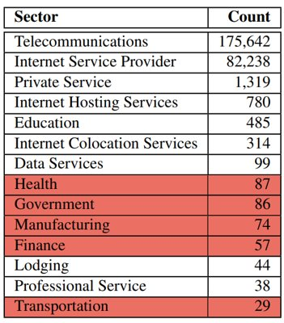
IoT Issues
IoT Paradigm
Cyber Threat
Damage Infrastructure
441k infected devices

Slide 4
Prior Works
Virgin: Local Classifier
Chad: Internet-Wide Classifier
Kumar: Banner Text
Guo: Local Packet Features
Limited Scope
Local network
Small Scale
Safei-Pour: Internet Traffic
Convolutional Model
Larger Scope
Every IoT device

Slide 5
Gaps in Knowledge
Comparative Performance
Model Efficiency
Data Reduction

Slide 6
Initial Assumptions
Complex Model = Best Performance
2D Kernel < 1D Kernels
Reduce Data → Reduce Performance

Slide 7
Methodology

Slide 8
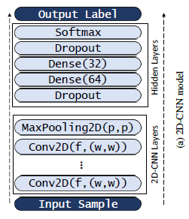
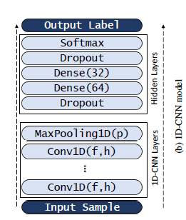
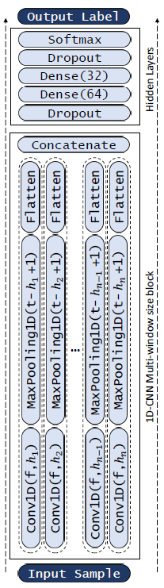
Convolutional Models
Processing Data
Spatial Orientation
Kernel Structure
1 Dimension
2 Dimensions
Layer Orientation
Sequential
Parallel

Slide 9
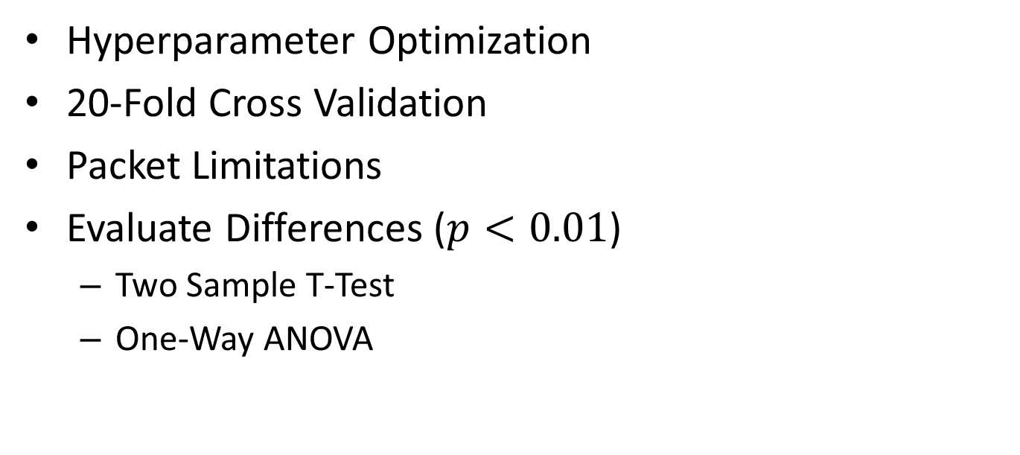
Evaluation
Hyperparameter Optimization
20-Fold Cross Validation
Packet Limitations
Evaluate Differences ($p<0.01$)
Two Sample T-Test
One-Way ANOVA

Slide 10
Limitations
Computer Hardware Malfunction
Power Draw → High Temperatures
Skew Run Time Results
Poor Initializations → Model Fails to Learn
Removed Such Runs

Slide 11
Results & Discussion

Slide 12
Results
Run Time
MW-1D-CNN > 2D-CNN > 1D-CNN
Model Performance
1D-CNN ≈ MW-1D-CNN > 2D-CNN
Packet Restriction
No Inter-model Difference
Above 230 Packets for 1D-CNN

Slide 13
Discussion
Model Complexity → Run Time
Kernel Structure → Performance
Surplus Data → Packet Restriction
Surplus = No Effect
1D-CNN Most Efficient

Slide 14
Conclusions & Implications

Slide 15
Conclusions
Analyze Accuracy and Efficiency
1D-CNN & MW-1D-CNN Highest Accuracy
1D-CNN Least Train Time
1D-CNN Most Efficient and Accurate
Initial Assumptions 1 & 3 Disproven

Slide 16
Implications and Future Research
Work → Pathway to Better Models
Critical Value → Push Efficiency Limits
Focus Solely on 1D Kernels
Future Research
Build Long Term Model
Link Cyber Threats
Develop Web-Based Platforms

Slide 17
Which Convolutional Neural Model Best and Most Efficiently Classifies Internet-Scale Infected Internet of Things Devices?

Slide 18
References
[1] | K. S. B. C. D. G. G. A. D. K. R. G. Z. D. Deepak Kumar, "All Things Considered: An Analysis of IoT Devices on Home Networks," in 28th USENIX Security Symposium, Santa Clara, 2019.
[2] | J. H. Hang Guo, "Detecting IoT Devices in the Internet (Extended)," University of Southern California Information Sciences Institute, Los Angeles, 2019.
[3] | M. B. A. S. J. D. G. M. O. N. O. T. Y. E. Yair Meidan, "ProfilIoT: A Machine Learning Approach for IoT Device Identification Based on Network Traffic Analysis," in SAC 2017: The 32nd ACM Symposium On Applied Computing, Marrakech, 2017.
[4] | S. M. I. H. N. A. A.-R. S. S. T. Markus Miettinen, "IoT SENTINEL: Automated Device-Type Identification for Security Enforcement in IoT," in 2017 IEEE 37th International Conference on Distributed Computing Systems (ICDCS), Atlanta, 2017.
[5] | S. M. M. M. H. F. N. A. A.-R. S. Thien Duc Nguyen, "DÏoT: A Federated Self-learning Anomaly Detection System for IoT," in 2019 IEEE 39th International Conference on Distributed Computing Systems (ICDCS), Dallas, 2019.
[6] | D. M. D. R. S. S. S. B. M. G. Vijayanand Thangavelu, "DEFT: A Distributed IoT Fingerprinting Technique," IEEE Internet of Things Journal, vol. 6, no. 1, pp. 940-952, 2019.
[7] | J. M. B. C. A. B. D. C. Antônio J. Pinheiro, "Identifying IoT devices and events based on packet length from encrypted traffic," Computer Communications, vol. 144, pp. 8-17, 2019.
[8] | R. R. M. N. O. T. Sandra Siby, "IoTScanner: Detecting and Classifying Privacy Threats in," in 3rd ACM International Workshop on IoT Privacy, Trust, and Security, IoTPTS ’17, Abu Dhabi, 2017.
[9] | D. Y. H. F. L. A. N. N. F. Gunes Acar, "Web-based Attacks to Discover and Control Local IoT Devices," in 2018 Workshop on IoT Security and Privacy, Budapest, 2018.
[10] | A. M. K. F. M. R. E. B.-H. I. K. S. A. E. Morteza Safaei Pour, "Data-driven Curation, Learning and Analysis for Inferring Evolving IoT Botnets in the Wild," in The 14th International Conference on Availability, Reliability and Security (ARES 2019), Canterbury, 2019.
[11] | A. M. K. F. M. R. E. B.-H. F. I. S. S. J. C. N. G. Morteza Safaei Pour, "On data-driven curation, learning, and analysis for inferring evolving internet-of-Things (IoT) botnets in the wild," Computers & Security, vol. 91, 2020.

